Slide 1
Monteggia fractures
Nyakure

Slide 2
Epidemiology
Injury defined as
proximal 1/3 ulnar fracture with associated radial head dislocation/instability
Epidemiology
rare in adults
more common in children with peak incidence between 4 and 10 years of age
different treatment protocol for children

Slide 3
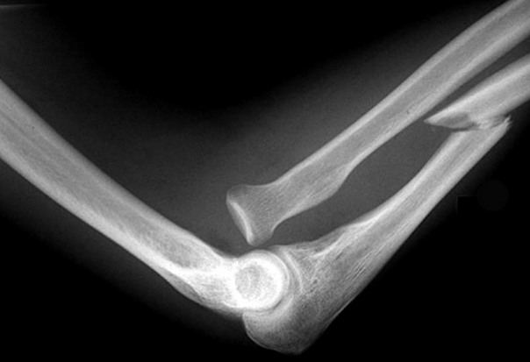
Image

Slide 4
Associated injuries
may be part of complex injury pattern including
olecranon fracture-dislocation
radial head fx
coronoid fx
LCL injury
terrible triad of elbow
Prognosis
if diagnosis is delayed greater than 2-3 weeks complication rates increase significantly

Slide 5
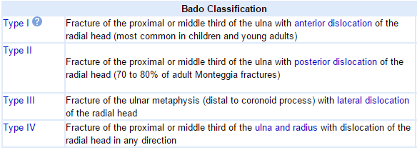
Classification

Slide 6
Clinical features
Symptoms
pain and swelling at elbow joint
Physical exam
inspection
may or may not be obvious dislocation at radiocapitellar joint
should evaluate skin integrity
ROM & instability
may be loss of ROM at elbow due to dislocation
neurovascular exam
PIN neuropathy
radial deviation of hand with wrist extension
weakness of thumb extension
weakness of MCP extension
most likely nerve injury

Slide 7
Imaging
Radiographs
recommended view
AP and Lateral of elbow, wrist, and forearm
CT scan
helpful in fractures involving coronoid, olecranon, and radial head

Slide 8
Nonoperative treatment
closed reduction
indications
more common and successful in children
must ensure stabilty and anatomic alignment of ulna fracture
technique
cast in supination for Bado I and III

Slide 9
Operative treatment
ORIF of ulna shaft fracture
indications
acute fractures which are open or unstable (long oblique)
comminuted fractures
most Monteggia fractures in adults are treated surgically
ORIF of ulna shaft fracture, open reduction of radial head
indications
failure to reduce radial head with ORIF of ulnar shaft only
ensure ulnar reduction is correct
complex injury pattern
IM Nailing of ulna
indications
transverse or short oblique fracture

Slide 10
Complications
PIN neuropathy
up to 10% in acute injuries
treatment
observation for 2-3 months
spontaneously resolves in most cases
if no improvement obtain nerve conduction studies
Malunion with radial head dislocation
usually caused by failure to obtain anatomic alignment of ulna
treatment
ulnar osteotomy and open reduction of the radial head

